Slide 2
1. Project Info

Slide 3
2. Game Overview & Vision

Slide 4
3. Core Gameplay Design

Slide 5
4. Game Mechanics & Systems

Slide 6
5. Narrative, World, & Characters

Slide 7
6. Level & Encounter Design

Slide 8
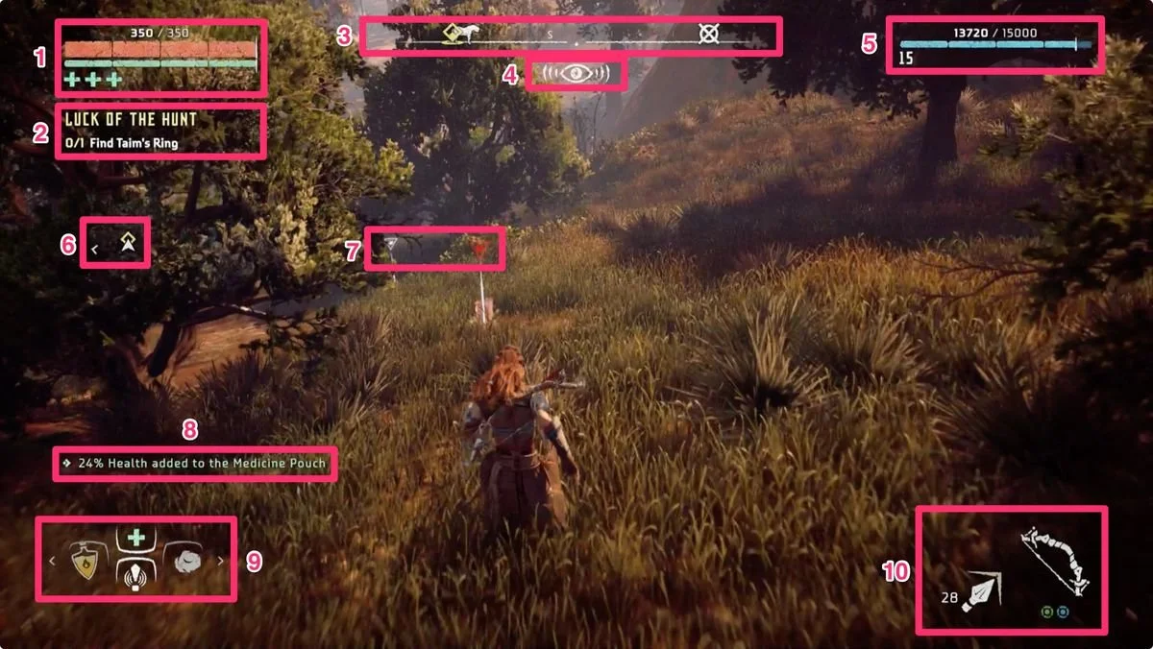
7. UI, UX, & Accessibility
Core Ui Elements:
Health/Shield bar (top-left)
Gold counter & wave timer (top-right)
Ammo & cooldown indicator (bottom-center)
Menus & Screens:
Main menu: Start, Settings, Quit
Pause Menu: Resume, Settings, Return to Main
Upgrade Vender: Upgrade options & cost
GameOver: Displays waves survived, kills, gold
https://www.iabdi.com/designblog/2022/6/1/nier-automata-chips

Slide 9
8.Production Team & Milestones
Team Roles
Elliotte Wideman
Project lead/Programmer/ Docs
Hunter Blake
Narrative Design/ Writing/Ui Ux/programmer
Chancelor Brown
Design Consultant/ Mechanics Testing/ Programmer
Development Milestones:
Pre-Production
(Sep 20 – Oct 5): Brainstorm + GDD
Sprint 1
(Oct 19 – 28): Movement, Shooting, HUG
Sprint 2
(Nov 9 –18): Wave logic, Vendor, Tutorial
Final Build
(Nov 23): Polish + presentation

Slide 10
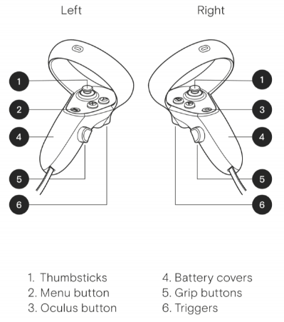
Risks & Out-of-Scope
Risks & Constraints:
Tight timeline and limited team size
Balancing difficulty curve
Hardware or testing issues
Out-of-Scope:
Multiplayer functionality
Procedural map generation
Branching storylines
Add VR/AR compatibility
Reference: image thumbsticks:
https://www.gamearter.com/blog/xr-input-manager-controllers

Slide 11
9. Schedules
Summary:
Pre-Production (Sep 20 – Oct 5): Concept + Setup
Sprint 1 (Oct 19 – 28): Core Mechanics
Sprint 2 (Nov 9 – 18): Systems + UI Integration
Deliverables (Nov 14 – 17): Poster Draft / C-Day Submission
Final Build (Nov 23): Polish and Release

Slide 12
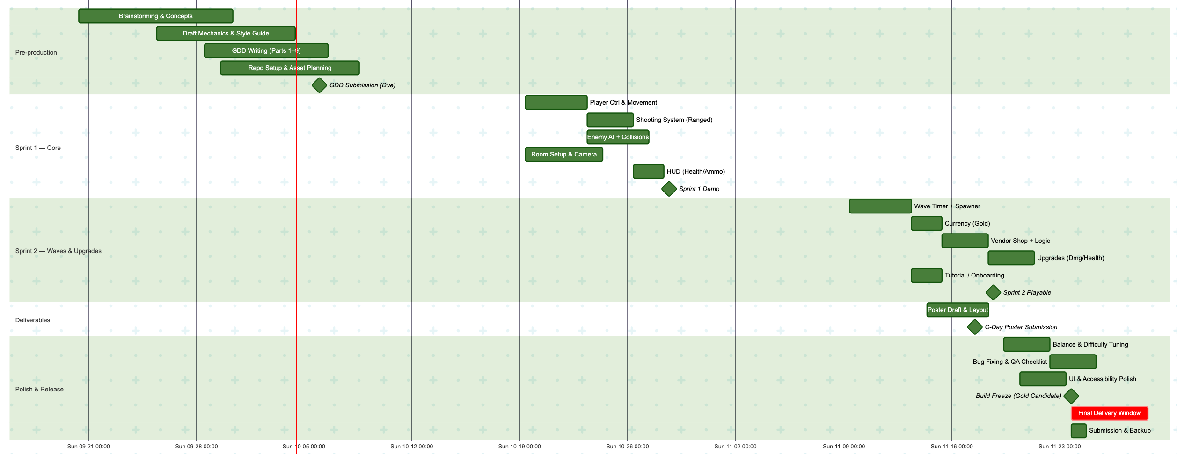
Gnatt Chart

